Slide 1
Price Controls Cause Chaos
Brian C. Albrecht
ICLE
Alex Tabarrok
George Mason University
Mark Whitmeyer
Arizona State University

Slide 2

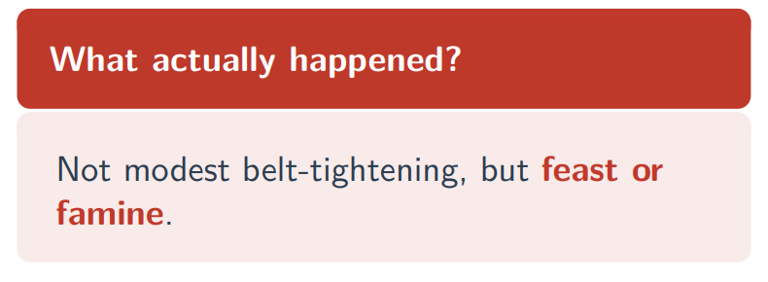
February 1974: The Oil Crisis
Aggregate gasoline shortfall: ≈ 9% nationwide
Price controls kept pump prices below market price
• Textbook prediction: each market gets a proportional ∼ 9% reduction
• Shadow prices equalize; Harberger triangle measures cost
“Gasoline was in short supply in major urban areas, but there were more than abundant supplies in rural and vacation areas, where the only shortage was of tourists.”

Slide 3
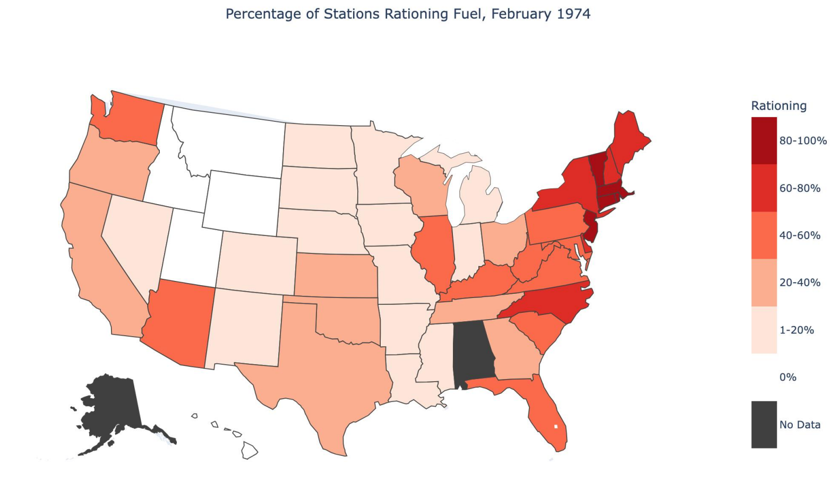
The Patchwork of Rationing
Severe rationing:
Connecticut, Massachusetts: > 90% of stations
New Jersey, Rhode Island: > 60%
No rationing at all:
Idaho, Montana, Utah, Wyoming: 0%
The question is not why some states rationed.
With a 9% national shortfall, shortages somewhere are inevitable.
The question is why other states exhibited no rationing.
Why should some markets clear while others run dry?
Answer: Efficient allocation requires price variation. A binding ceiling explicitly forbids it.
Percentage of gasoline stations rationing fuel by state, February 1974. Rationing includes stations completely out of fuel and those limiting purchases (e.g., maximum gallons per customer). Data are from AAA surveys of sampled stations.

Slide 4
This Paper: Four Contributions
1. Price Controls Create Corner Allocations
Price controls generically produce corner allocations. Some markets get everything; others get nothing.
2. The Chaos Theorem
Small parameter changes cause discontinuous jumps.
3. Robust Bounds on Welfare
Sharp welfare bounds without assuming a demand functional form. Computation reduces to a 1D optimization.
4. 1973–74 Gasoline Crisis
Misallocation losses are much larger than the Harberger triangle. Misallocation generates more welfare loss than the quantity reduction.

Slide 5
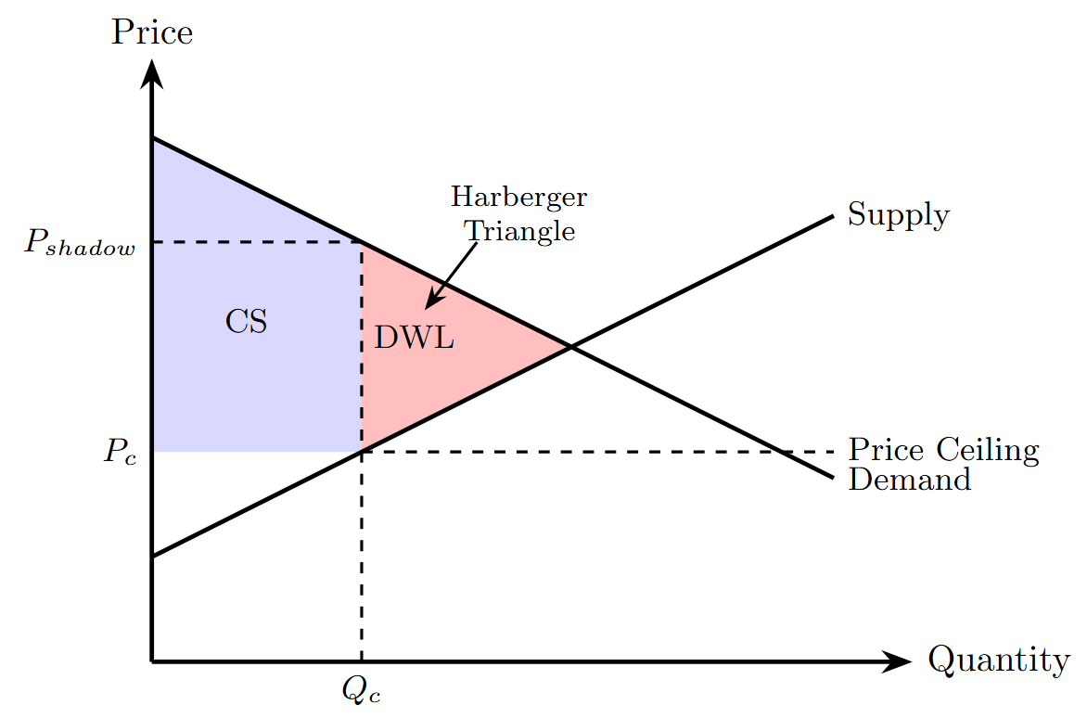
Harberger Triangle
Econ 101: A price ceiling at Pc creates DWL given by the Harberger Triangle.
But note that this assumes that allocation is efficient. That is it assumes that the Qc of output is allocated to the demanders with the highest willingness to pay (WTP).
But why should this be?
Note that there are many more people willing to pay a price higher than Pc.
How can the consumers with the highest willingness to pay outbid consumers with a lower WTP when prices are fixed by law?
Demanders
with Highest
WTP
A price ceiling at Pc creates DWL given by the Harberger Triangle

Slide 6
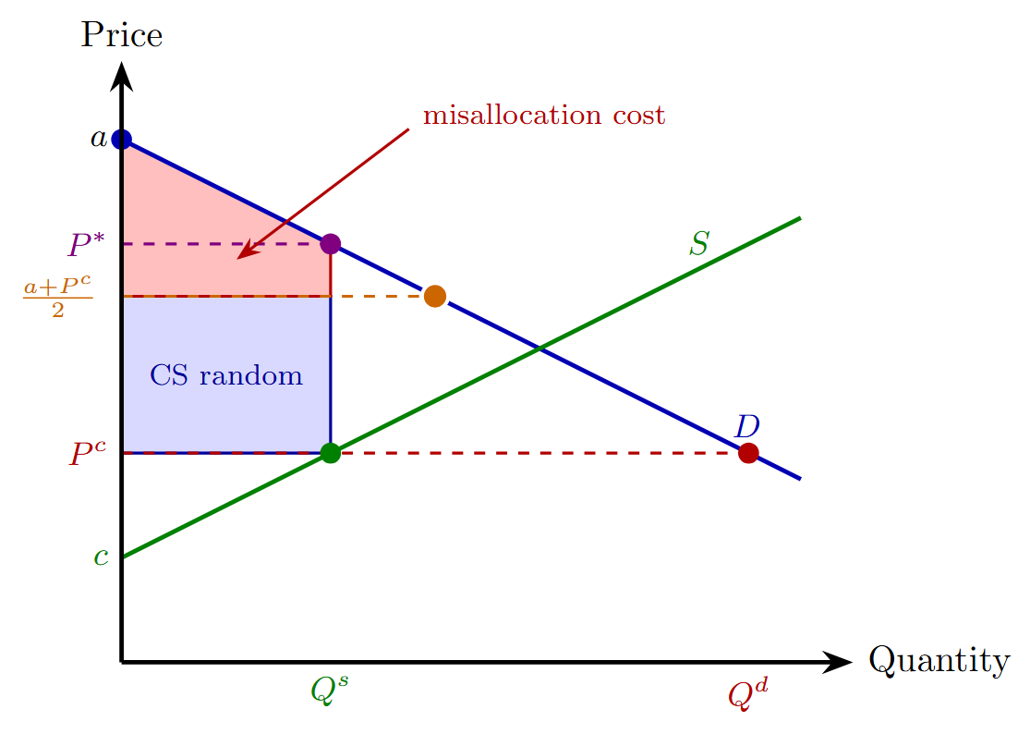
Random Allocation
A natural response is to ask what happens under random allocation?
Since under random allocation some output now goes to consumers who value it less than the highest willingness to pay, deadweight loss increases.
By how much?
Two neat visuals.
Harberger Triangle

Slide 7
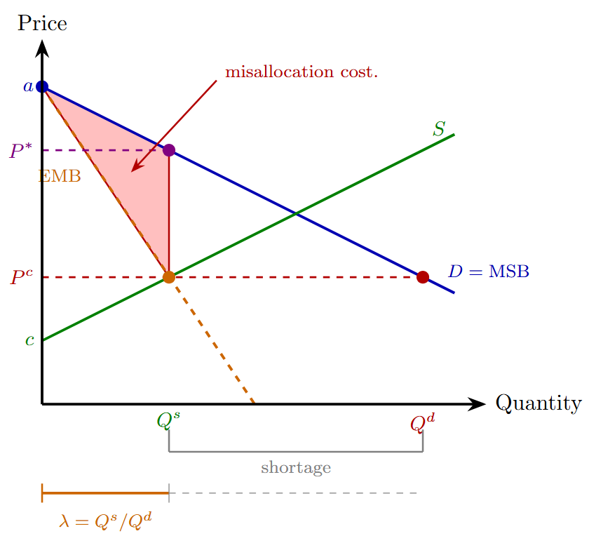
Random Allocation
A natural response is to ask what happens under random allocation?
Since under random allocation some output now goes to consumers who value it less than the highest willingness to pay, deadweight loss increases.
By how much?
Two neat visuals.
Harberger Triangle

Slide 8
Random Allocation
Random allocation has been studied by Glaeser and Luttmer (2003) and Bulow and Klemperer (2012) (among others).
Glaser and Luttmer (2003) argue that 21% of the apartments under NYC rent control are misallocated—leading to substantial welfare losses.
Bulow and Klemperer study when random allocation result in large misallocation losses: Requires information on log convexity, log concavity etc. of demand curves. Not obvious!
Think instead about market segments: geographic, temporal, input-output....
We study all possible allocations to different market segments.

Slide 9
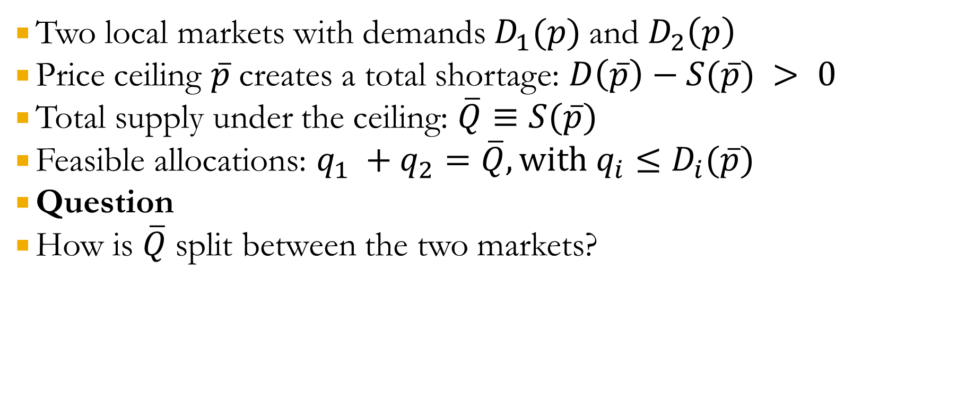
Setup: Two Segments/Submarkets
Two local markets with demands $D_{1}(p)$and $D_{2}\left(p\right)$
Price ceiling $\overline{p}$creates a total shortage: $D\left(\overline{p}\right)−S(\overline{p}) > 0$
Total supply under the ceiling: $\overline{Q}≡S(\overline{p})$
Feasible allocations: $q_{1} +q_{2}=\overline{Q}, with{ q}_{i}≤D_{i}(\overline{p})$
Question
How is $\overline{Q}$split between the two markets?

Slide 10
Harberger Requires Equalization of Shadow Prices
For the Harberger triangle to represent DWL requires that shadow prices be equalized in all segments such that the sum of the segment quantities equals the quantity supplied at the controlled price.
Why should shadow prices equalize when fixed money prices eliminate arbitrage incentives?
Notes:
Note shadow prices. Note we from herein we ignore production deadweight loss as this will be constant across all misallocations (e.g. oil from foreign country).

Slide 11
An Equally Feasible Allocation
Note in Panel B segment 2 gets zero allocation and segment 1 gets over-allocation.
Divergence of shadow prices.
As a result a+b>c

Slide 12
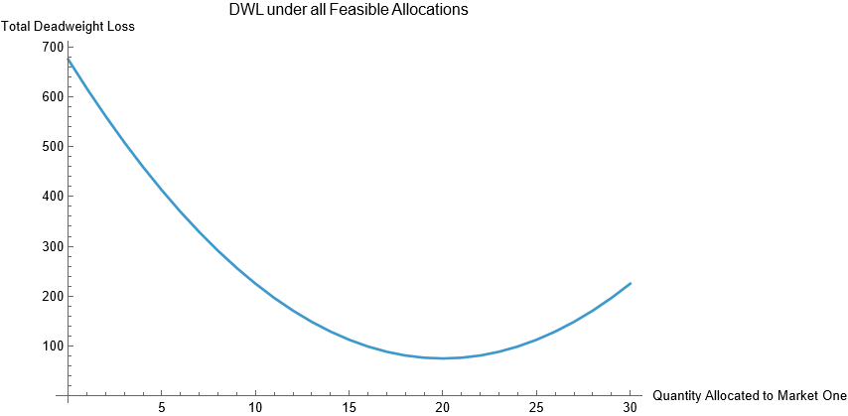
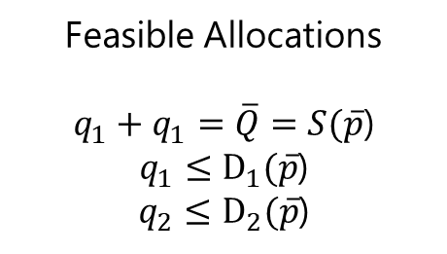
Harberger Triangle Is the Minimum Deadweight Loss
Feasible Allocations
$q_{1}+q_{1}=\overline{Q}=S(\overline{p}$)
$q_{1}≤D_{1}(\overline{p}$)
$q_{2}≤D_{2}(\overline{p}$)
Vertex
Allocations
Harberger

Slide 13
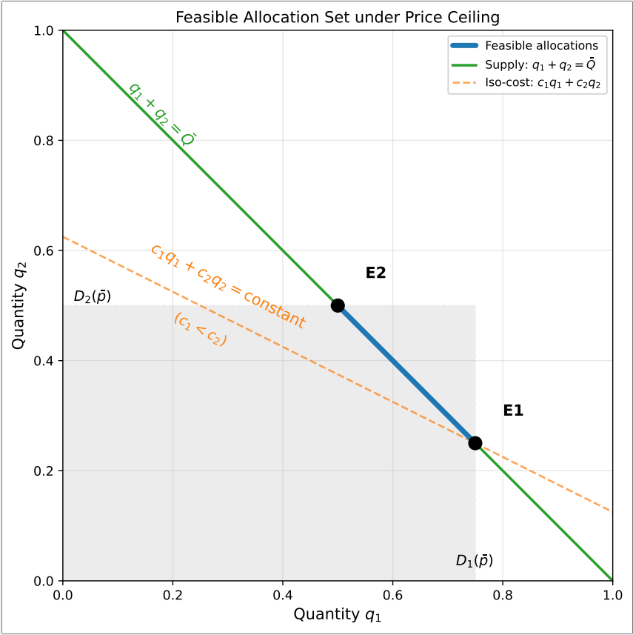
Why Corners?
Think of transportation costs. Two markets. Prices are fixed. To which do you deliver? Ideally, deliver everything to the market with lowest transport cost.
More generally: the feasibility constraints are shown at right. Convex polytope. Linear program->Corner solutions.
Any outcome from E2 to E1 is feasible but generically the outcomes are E2 and E1 depending on transport costs.
“Segment”, “Transport”—very general terms.

Slide 14
Why Corners?
The logic in four steps
Prices frozen → sellers earn the same revenue everywhere
Seller indifference → allocation by cost minimization
Cost minimization is a linear program on the feasible set
Linear programs solve at corners
The knife-edge:
Under market prices, a slight cost advantage for PA over NJ redirects a few tanker loads.
Under price controls, it redirects all of them. A one-cent advantage is as good as one dollar.
Notes:
In a free market, a slight cost advantage for Pennsylvania over New Jersey matters only at the margin—a few tanker loads of oil—not all of them.
The price mechanism permits fine-grained reallocation because arbitrageurs capture profits proportional to the price gap.
When prizes are frozen, these incremental profit opportunities disappear.

Slide 15
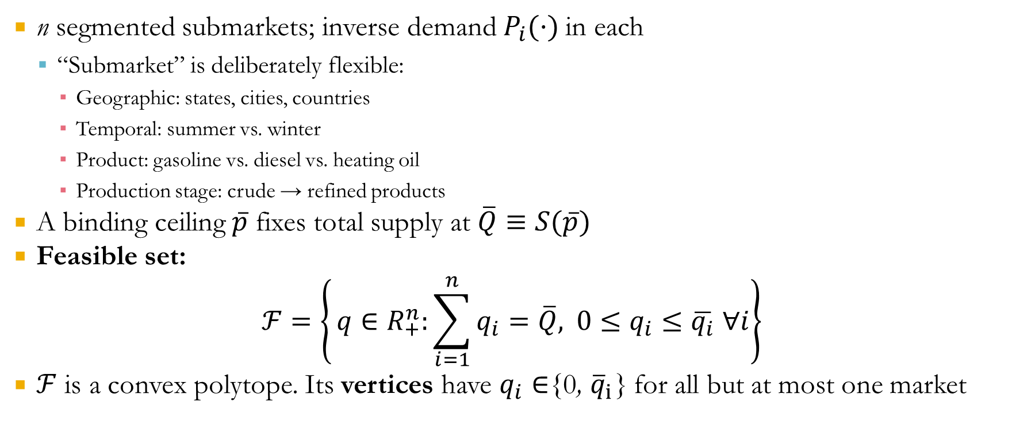
From Two to Many
n segmented submarkets; inverse demand $P_{i}(·)$in each
“Submarket” is deliberately flexible:
Geographic: states, cities, countries
Temporal: summer vs. winter
Product: gasoline vs. diesel vs. heating oil
Production stage: crude → refined products
A binding ceiling$\overline{p}$ fixes total supply at $\overline{Q}≡S(\overline{p})$
Feasible set:
$$ℱ=\left\{ q∈R_{+}^{n}:\sum_{i=1}^{n}{q_{i}}=\overline{Q}, 0≤q_{i}≤\overline{q_{i}} ∀i\right\}$$
$ℱ$ is a convex polytope. Its vertices have $q_{i}∈${0, ${\overline{q}}_{i}$} for all but at most one market

Slide 16
Without price controls markets drive outcomes to generically interior solutions that maximize welfare.
Under price controls “markets” drive outcomes to generically corner solutions with no welfare implications.
One of the corner solutions under price controls is the worst case.

Slide 17
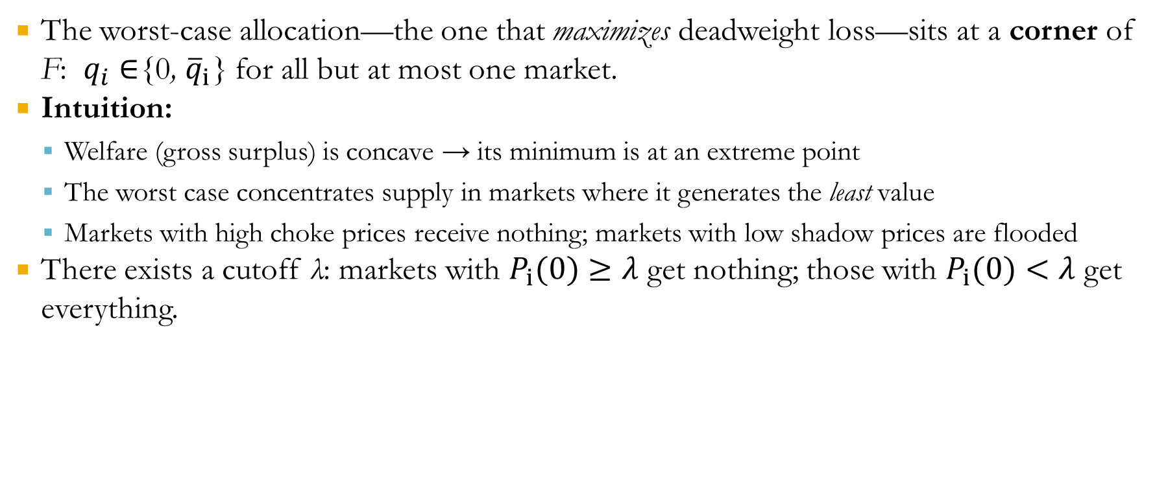
Theorem 1 (Worst Case)
The worst-case allocation—the one that maximizes deadweight loss—sits at a corner of F: $q_{i}∈${0, ${\overline{q}}_{i}$} for all but at most one market.
Intuition:
Welfare (gross surplus) is concave → its minimum is at an extreme point
The worst case concentrates supply in markets where it generates the least value
Markets with high choke prices receive nothing; markets with low shadow prices are flooded
There exists a cutoff λ: markets with $P_{i}(0)≥λ$ get nothing; those with $P_{i}(0)<λ$ get everything.

Slide 18
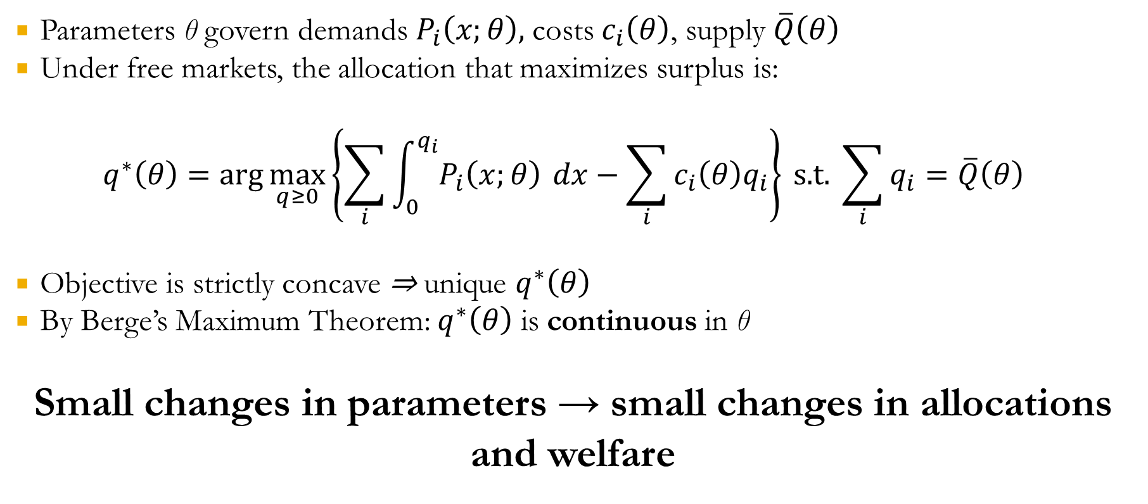
Markets are Smooth
Parameters θ govern demands $P_{i}\left(x;θ\right),$costs $c_{i}\left(θ\right)$, supply $\overline{Q}\left(θ\right)$
Under free markets, the allocation that maximizes surplus is:
$$q^{∗}\left(θ\right)=\arg{\max_{q≥0}\left\{\sum_{i}{\int_{0}^{q_{i}}{P_{i}\left(x;θ\right)}} dx−\sum_{i}{c_{i}\left(θ\right)q_{i}}\right\}} \text{s}\text{.}\text{t}\text{.} \sum_{i}{q_{i}}=\overline{Q}\left(θ\right)$$
Objective is strictly concave ⇒ unique $q^{∗}\left(θ\right)$
By Berge’s Maximum Theorem: $q^{∗}\left(θ\right)$ is continuous in θ
Small changes in parameters → small changes in allocations and welfare

Slide 19
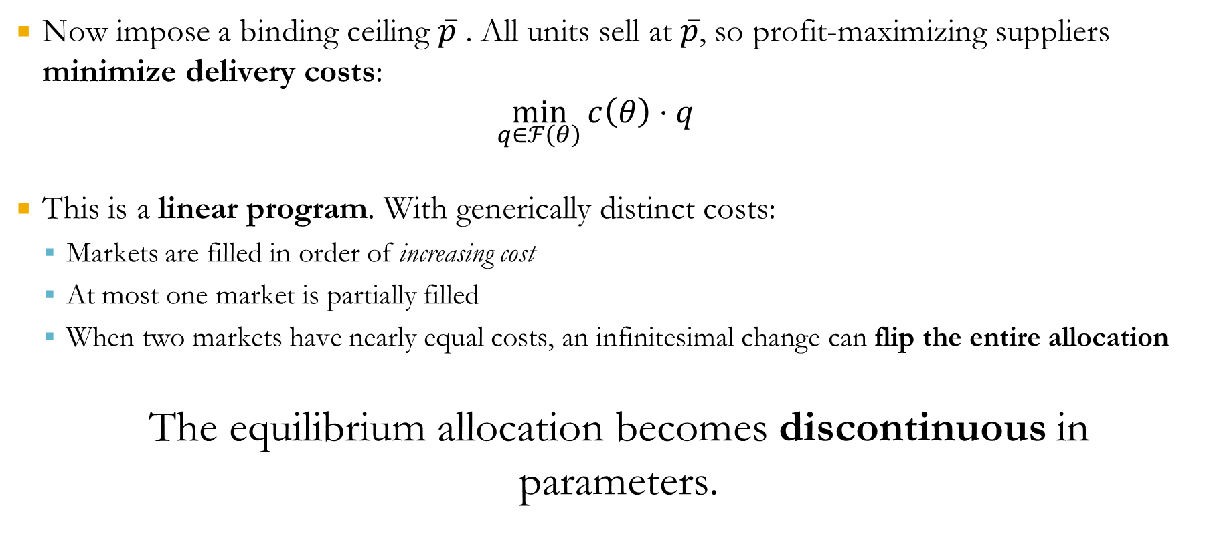
Under Price Controls: Cost Minimization
Now impose a binding ceiling $\overline{p}$ . All units sell at $\overline{p}$, so profit-maximizing suppliers minimize delivery costs:
$$\min_{q∈ℱ\left(θ\right)}{c\left(θ\right)}⋅q$$
This is a linear program. With generically distinct costs:
Markets are filled in order of increasing cost
At most one market is partially filled
When two markets have nearly equal costs, an infinitesimal change can flip the entire allocation
The equilibrium allocation becomes discontinuous in parameters.

Slide 20
The Chaos Theorem
Suppose two adjacent vertex allocations v and w are both optimal at some parameter θ∗. If the welfare difference ∆W ̸= 0 (a generic condition), then for every neighborhood of θ∗:
1. The optimal allocation jumps discontinuously between v and w
2. Welfare jumps by +|∆W| along one path and -|∆W| along another
Welfare is not locally monotone: arbitrarily small perturbations can move welfare up or down by discrete amounts.
A pipeline repair, a regulatory tweak, a refinery outage—any small change in relative costs can flip the entire allocation, with potentially catastrophic welfare consequences.

Slide 21
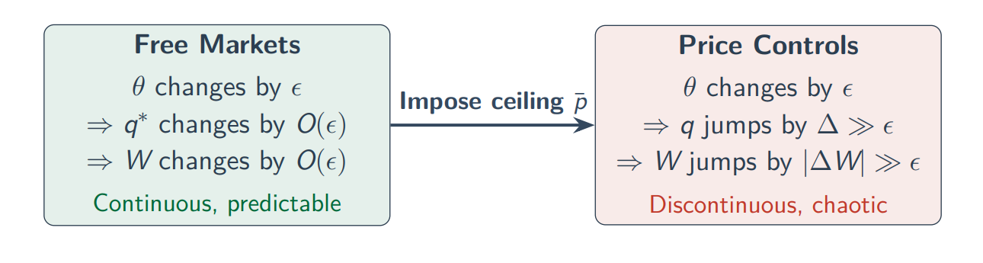
The Chaos of Price Controls: Intuition
Price controls introduce fundamental unpredictability. Allocations become hypersensitive to “nuisance parameters” that would be irrelevant under free markets.

Slide 22
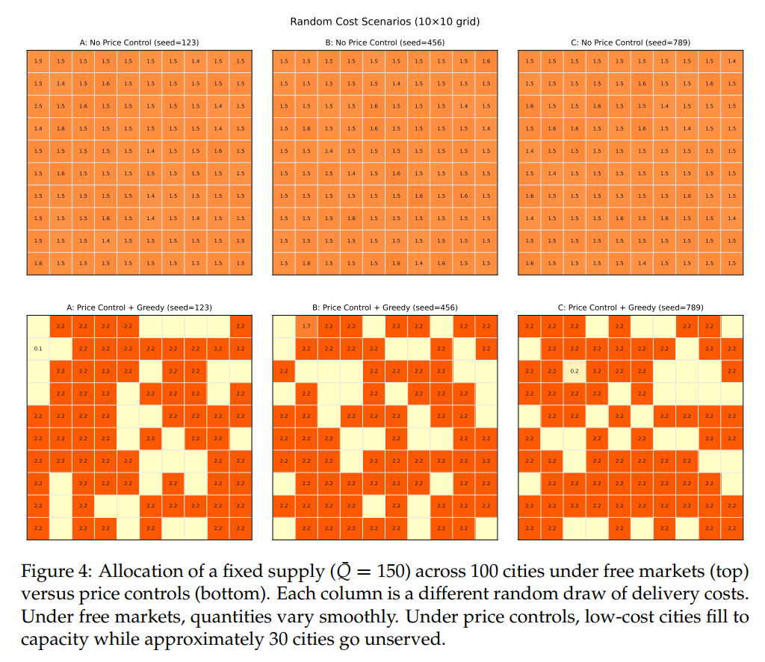
The Chaos Theorem: Simulation
We simulate 100 cities on a 10x10 grid. Each city has the same demand but very small, slightly different costs of supply, drawn randomly.
Top row shows free market allocations—each with different cost of supply.
Bottom row shows allocations under price control with the same cost of supply in the column.
Red is served. Yellow is zero allocation.
Notes:
Free-market allocations are nearly identical across scenarios—small cost
differences → small allocation differences
2. Under price controls, many markets receive zero (yellow)—low-cost cities fill
to capacity; ∼ 30 cities get nothing
3. Different cost draws → radically different allocations—same demand, same
supply, completely different spatial pattern

Slide 23
Illustration: 1971-1974 Oil Crisis
August 1971: Nixon freezes all wages and prices/
Petroleum remains under controls even after other prices unfrozen
August 1973: Special Rule No. 1 — mandatory petroleum controls
October 1973: Oil Embargo begins; market price triples
Controls + embargo = severe shortages
EPAA (1973): Allocation system based pro-rata on 1972 levels
If supply falls to 90% of 1972, each buyer gets 90% of 1972 allocation
Plus exceptions for defense, agriculture, essential services…All under a “fair and equitable” guideline
Despite pro-rata rules, the outcome was extreme dispersion—exactly what the Chaos Theorem predicts

Slide 24
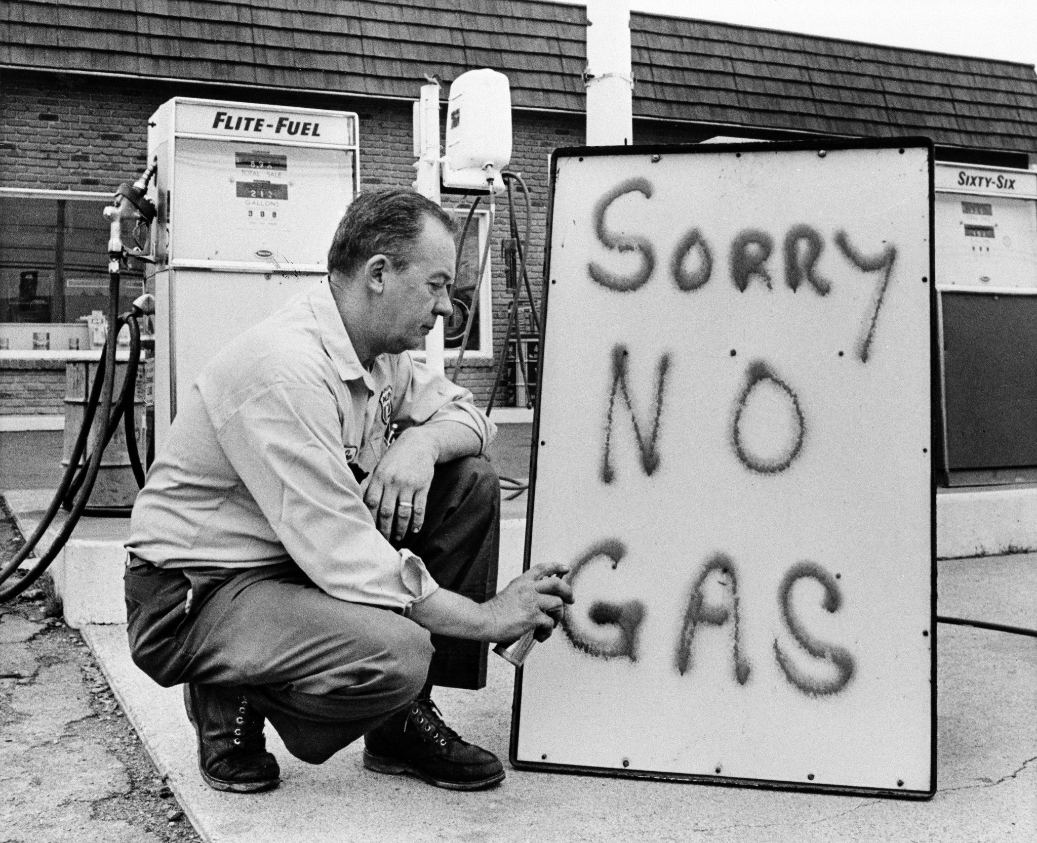
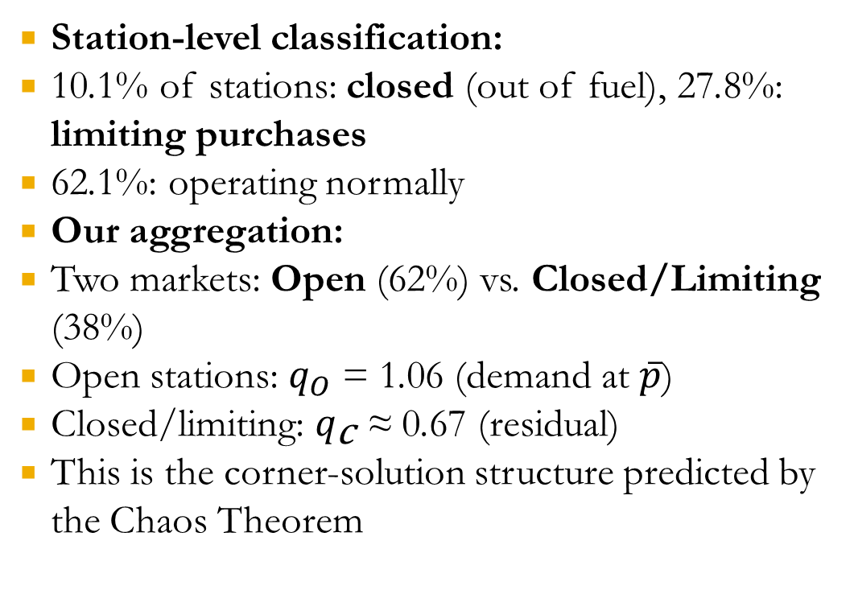
The Data: AAA Station Surveys, February 1974
Station-level classification:
10.1% of stations: closed (out of fuel), 27.8%: limiting purchases
62.1%: operating normally
Our aggregation:
Two markets: Open (62%) vs. Closed/Limiting (38%)
Open stations: $q_{O}$ = 1.06 (demand at $\overline{p}$)
Closed/limiting: $q_{\text{c}}$ ≈ 0.67 (residual)
This is the corner-solution structure predicted by the Chaos Theorem
Notes:
1979 Barely 50 stations were open in Connecticut.and in New Jersey less than 500 of thestate's 6,1m stations were open. In New YorkCity, Westchester County and Long Island,less than 5 per cent of the stations sold gasoline. Police call for help in qasoline riots Chicago Tribune (1979) Chicago, Ill.. 26 June 1979:2

Slide 25
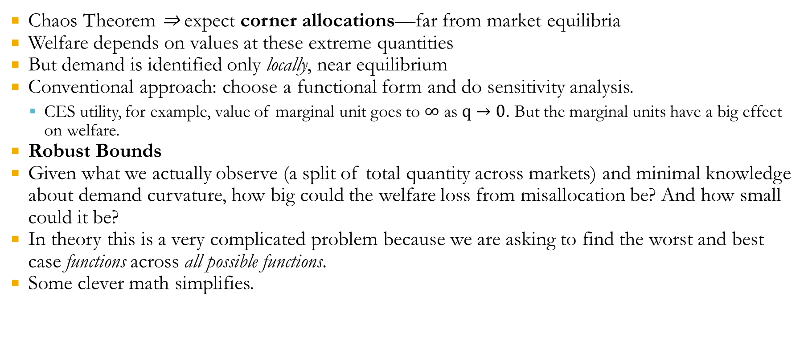
The Identification Problem
Chaos Theorem ⇒ expect corner allocations—far from market equilibria
Welfare depends on values at these extreme quantities
But demand is identified only locally, near equilibrium
Conventional approach: choose a functional form and do sensitivity analysis.
CES utility, for example, value of marginal unit goes to $∞$ as $q→0$. But the marginal units have a big effect on welfare.
Robust Bounds
Given what we actually observe (a split of total quantity across markets) and minimal knowledge about demand curvature, how big could the welfare loss from misallocation be? And how small could it be?
In theory this is a very complicated problem because we are asking to find the worst and best case functions across all possible functions.
Some clever math simplifies.

Slide 26
The Chaos Mechanism in General
Product-mix misallocation:
A barrel of crude → gasoline, diesel, heating oil, jet fuel…
Controlled prices + small cost wedges→ large shifts in fuel mix
Shortages rotated unpredictably across fuels gasoline one week, propane the next, diesel after that...
Temporal misallocation:
Heating oil prices frozen at summer 1971 levels
Weakened incentives to store for winter
Winter shortages, school closures
“Freezing prices led to freezing people”
Phases 3 and 3A have created price anomalies that frequently prevent the movement of products in proper directions. — 1973 Congressional testimony

Slide 27
The Chaos Mechanism: The Baby Chicks
In summer 1973, chicken farmers gassed, drowned, and suffocated roughly one million baby chicks. The mechanism:
Retail chicken prices: controlled
Feed costs: not controlled
Revenue capped along the grow-out path
Small feed-cost increases → abandon “raise chicks” segment entirely.
Similar story with cows, and pigs. Cull now when future price<current price.
Corner Solution: Small cost wedges->vertex; all supply to “now” zero to “later”
“It’s cheaper to drown ’em than to put ’em down and raise ’em.”
— AP, 1973

Slide 28
Supply-Chain Breaking
Allocation rules designated priority end uses
But policymakers rarely understood full input–output linkages
Example: Propane → plastic pipe → oil wells
Oil production was prioritized
Propane: essential for plastic piping used in oil extraction
Plastics industry initially lacked priority designation and propane price was frozen. High-value demanders could not out-bid low value demanders. Suppliers sent propane anywhere costs of transport were low.
Result: Pipe shortages disrupted the very oil production that policy sought to protect

Slide 29
Political Economy
Once prices can’t do their job, “the market” delivers corner outcomes with no welfare ordering.
Thus, it would not be surprising if mandated allocation could outperform the allocation under price controls.
Thus:
Shortage-chaos → demand for quantity management → yield regulations, inventory mandates, bureaucratic allocation.
Notes:
Very evident from congressional reports where many people can’t understand the chaos—everything used to work why doesn’t it work now. We need oil!

Slide 30
Summary of Results
1. Price Controls Create Corner Allocations
Price controls generically produce corner allocations. Some markets get everything; others get nothing.
2. The Chaos Theorem
Small parameter changes cause discontinuous jumps.
3. Robust Bounds on Welfare
Sharp welfare bounds without assuming a demand functional form. Computation reduces to a 1D optimization.
4. 1973–74 Gasoline Crisis
Misallocation losses are much larger than the Harberger triangle. Misallocation generates more welfare loss than the quantity reduction.

Slide 31
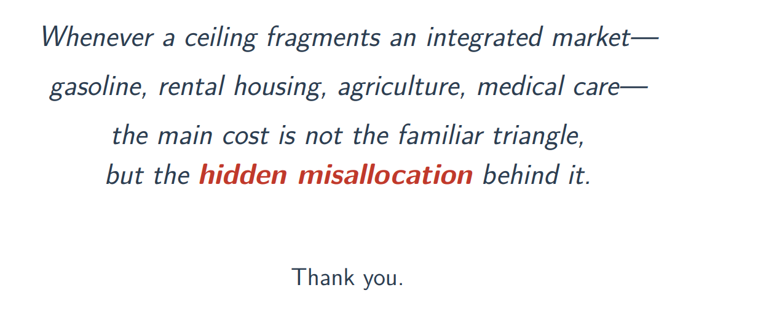
Final Words

